Slide 1
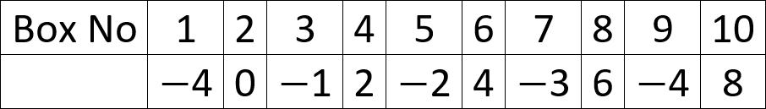
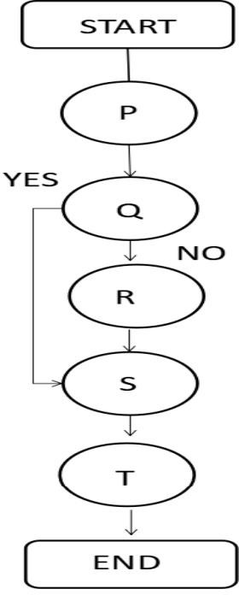
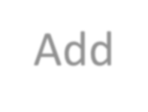

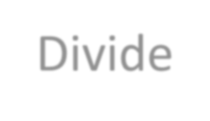
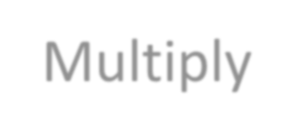
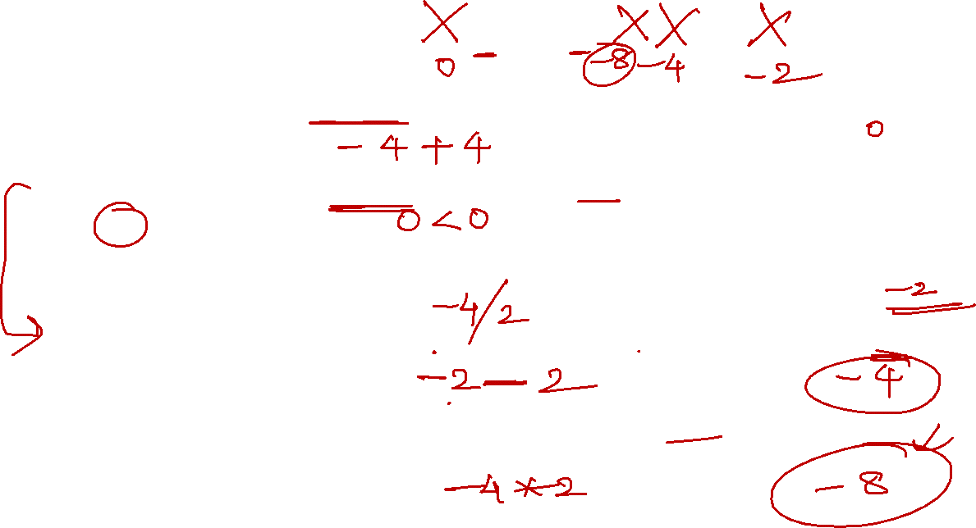
P-> Add: (number in Box 9)+(number in Box 6). Put the result in Box 3.
Q-> Is (number in Box 2) < (number in Box 3)?
R-> Divide : (number in Box 1) / (number in Box 4). Put the result in Box 10.
S-> Add: (number in Box 10) + (number in Box 5). Put the result in Box 8.
T-> Multiply: (number in Box 8) * (number in Box 4). Put the result in Box 7.

Slide 2
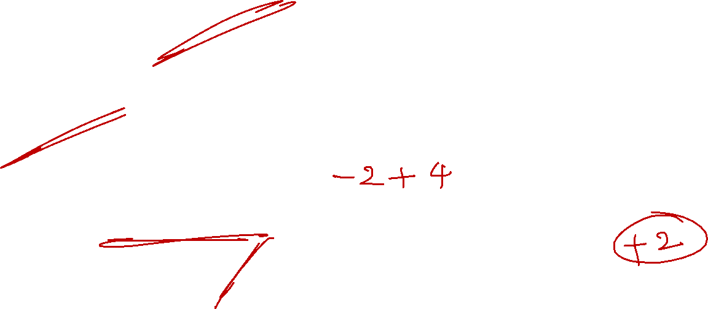
i) At the end of the flowchart which of the following boxes will have the lowest value?
a. Box 8 b. Box 7 c. Box 2 d. Box 10
ii) How many boxes have positive integral values at the end of flowchart?
a. 2 b. 4 c. 6 d. 0
iii) Find the value of {(number in Box 10) + (number in Box 6)} at the end of the flowchart.
a. 4 b. −2 c. 2 d. − 4

Slide 3
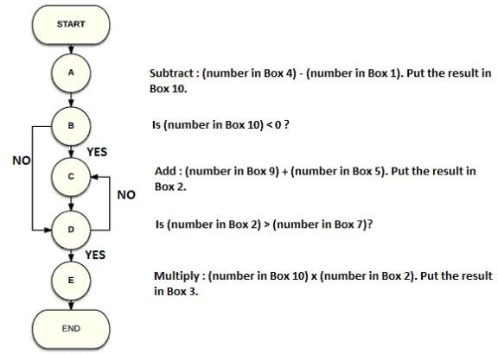
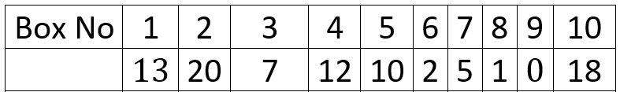
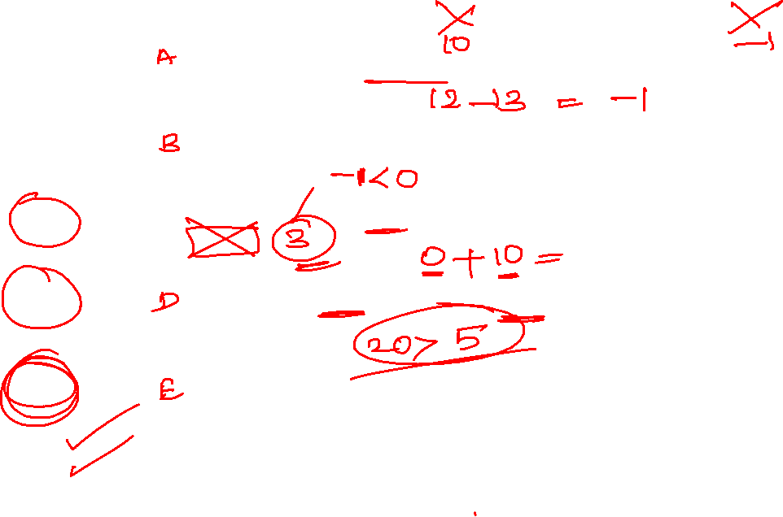

Slide 4

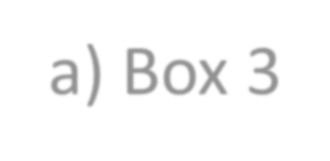

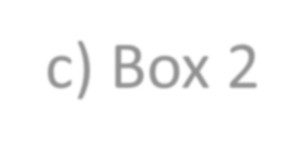
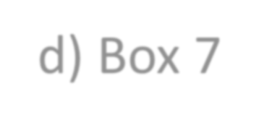

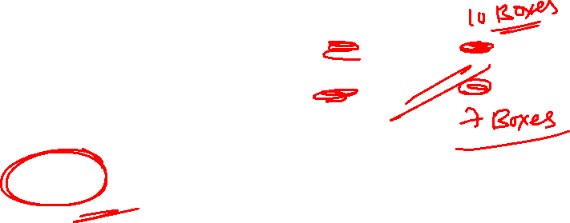
a) Box 3
c) Box 2
b) Box10
d) Box 7
At the end of the flow chart the number placed in which of the following boxes will remain unchanged?

Slide 5
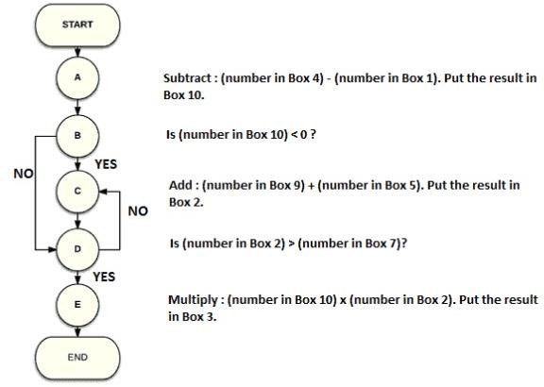
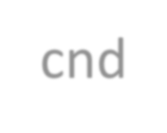


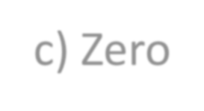
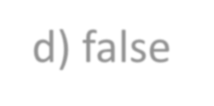

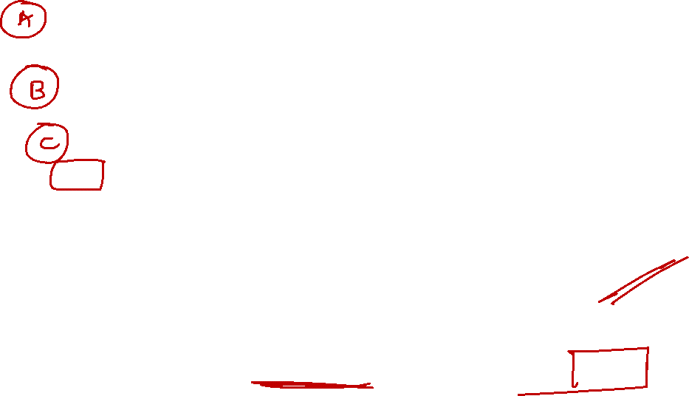
a) true
b) cnd
d) false
c) Zero
Is the following statement True or False?
If the condition in Step C updates the value in Box 3 instead of Box 2, then the flow chart will enter into infinite loop

Slide 6
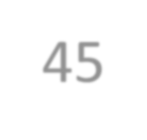

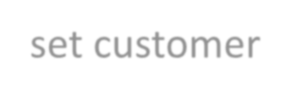
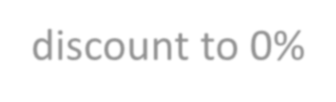
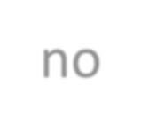

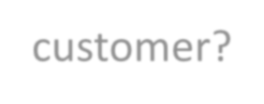

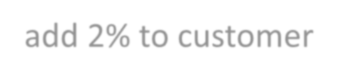
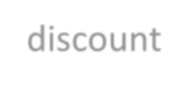
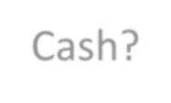





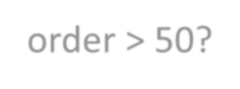



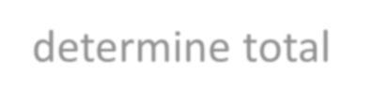
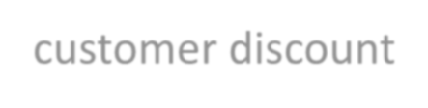
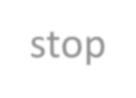
What will be the total discount for a wholesale customer who buys more than 50 orders but does not pay in cash?
45
start
set customer discount to 0%
4%
6%
2%
0%
no
wholesale customer?
yes
add 2% to customer discount
Cash? _{yes}
no
add 2% to customer discount
no
order > 50?
yes
add 2% to customer
discount
determine total
customer discount
stop

Slide 7
What will be the total discount for a wholesale customer who buys more than 50 orders and pays in cash?
start
set customer discount to 0%
4%
6%
2%
0%
no
wholesale customer?
yes
add 2% to customer discount
Cash? _{yes}
no
add 2% to customer discount
no
order > 50?
yes
add 2% to customer
discount
determine total
customer discount
stop

Slide 8
start
What will be the total discount for
a non-wholesale customer who buys
less than 50 orders and does not pay cash?
4%
6%
2%
0%
set customer discount to 0%
no
wholesale customer?
yes
add 2% to customer discount
Cash? _{yes}
no
add 2% to customer discount
no
order > 50?
yes
add 2% to customer
discount
determine total
customer discount
stop

Slide 9

?
Problem Figure:
Response Figure:
a
b
c
d

Slide 10
?
Problem Figure:
Response Figure:
a
b
c
d

